Slide 1
SEMESTER PROJECT PRESENTATION-Team-5
Modeling Quality of Suggestions
By- Sai Sri Harsha Kumbam EF41093
Ramya Jyotsna Neelakantrao WI30334. Harshith Martha TZ18899.

Slide 2
INTRODUCTION.
Dataset origin and purpose
The dataset is derived from an online forum hosted by a large human resource company, where employees submit suggestions to upper management.
Each suggestion corresponds to a unique thread identified by a suggestion ID. The forum allows for responses, voting, and viewing of suggestions.
The purpose of the project is to make recommendations using the machine learning algorithms.

Slide 3
Previous Approach
Intern Highlighting Process:
A group of interns manually evaluated and highlighted approximately 500 suggestions deemed worthy of follow-up. However, this manual process is considered impractical for scalability and sustainability, prompting the need for a more efficient method to narrow down future searches for valuable suggestions.

Slide 4
Motivation and Objective
The dataset includes details about suggestion authors, such as the number of posts they have made on the forum and their tenure with the company measured in days. This additional information can potentially be leveraged to develop a method for automatically identifying high-value suggestions, reducing the manual effort required for future evaluations.

Slide 5
USE CASE
Efficient Suggestion Evaluation.
Scalability
Time And Resource Saving.
Improved Decision Making
Data Insights.

Slide 6
Synopsis of Dataset(Before Cleaning the Dataset)
Shape of the dataset is : (16429,10)
It contains of 16429 instances and 10 attributes.
The attributes are as follows:
Recommended: Indicates whether the suggestion was recommended (0 for not recommended, 1 for recommended).
Suggestion_Id: The unique identifier for each suggestion.
Responses: The number of responses to the suggestion.
Views: The number of views the suggestion received.
Votes_Up: The number of upvotes for the suggestion.
Votes_Down: The number of downvotes for the suggestion.
Author_Id: The unique identifier for the author of the suggestion.
Author_Join: The number of days since the author joined the platform.
Author_TotalPosts: The total number of posts made by the author.
Author_PostsPerDay: The average number of posts made per day by the author.

Slide 7
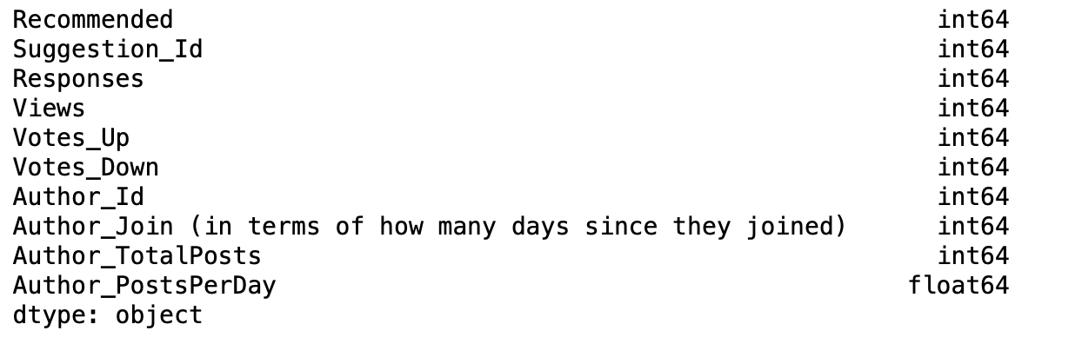
Datatypes of the attributes.

Slide 8
Data Cleaning
The data cleaning of this dataset included the following steps:
Identifying the missing values.
Checking for duplicate values and deleting them.
Checking for null values.
Notes:
For duplicate values we have deleted the second occurrence values which are getting repeated more than once, so we choosed only the first coherence values taking into consideration the unique column i.e suggestion_id in our case

Slide 9
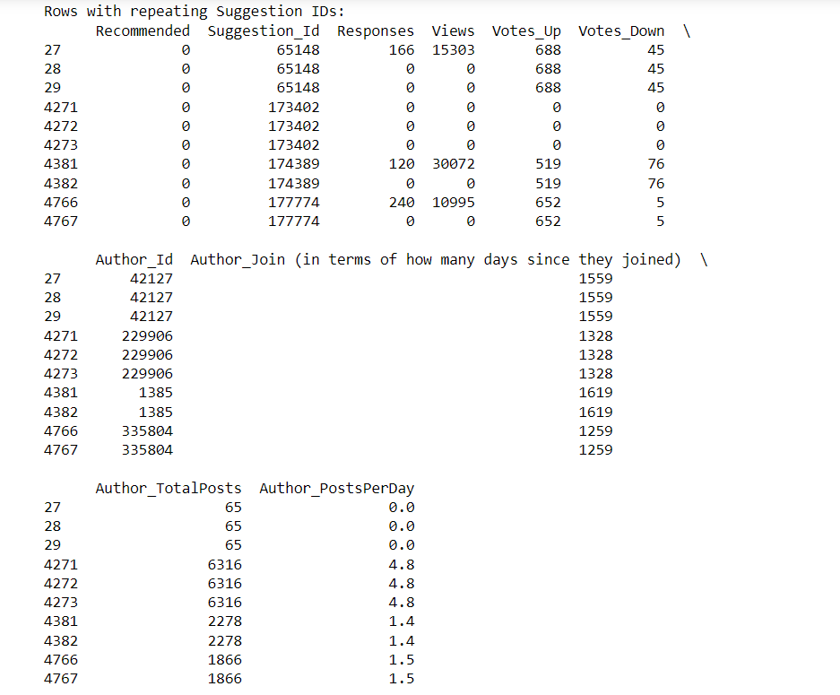
Identifying the repeated suggestion_id from the dataset
Notes:
From our dataset the feature named Suggestion_id had the Unique values.
If we have datafield with same suggestion_id and are getting repeated more than once
To identify the unique column we have first analyzed the data from the dataset where we have identified that the suggestion_id and Author_id are being the same but other fields like Responses, views, votes_up, votes_down there is some field’s being 0, then in this cases we have removed those rows where both the rows are being same and retained only thoses rows which had maximum values or any data other than 0 and thus through his Suggestion_id was made as the unique column and thus the dataset got filtered with these changes.

Slide 10
Methodology
We have used Z-score method for Outlier Detection
For Class Imbalance we have used Class Weights and SMOTE Analysis Methods
Performed Feature Importance
Machine Learning Models

Slide 11
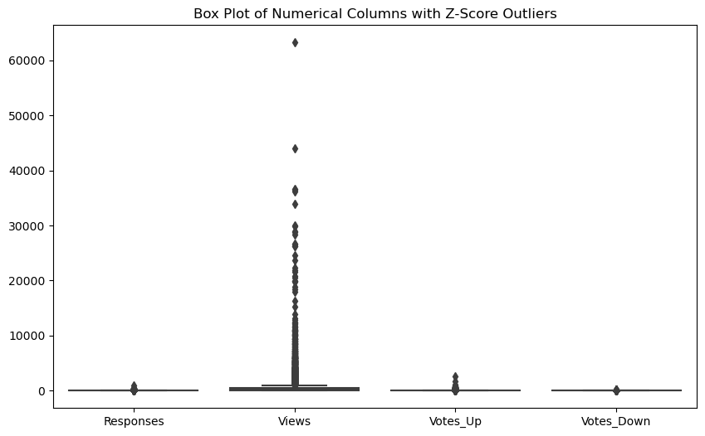
Filtering Outliers
We have identified the following outliers in our dataset Responses': 262, 'Views': 164, 'Votes_Up': 197, 'Votes_Down': 202
And have decided to handle them as these datapoint are being significantly different from the rest of our dataset
Result:
Original row count: 14563
New row count after removing outliers: 13545
Percentage decrease in data: 6.990317928998147

Slide 12
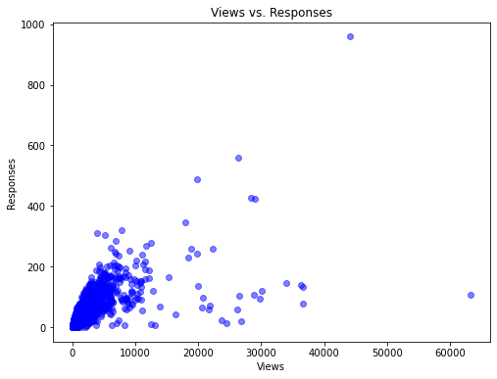
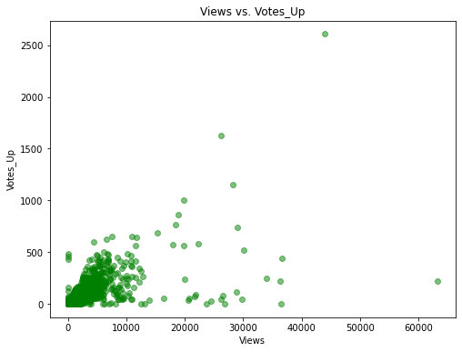
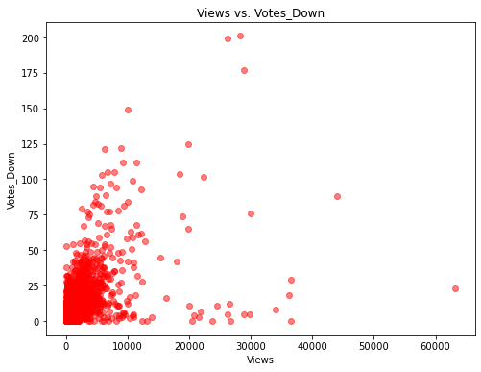
Data Visualisation Before Applying the Conditions.
This scatter plot represents the Views Vs Responses.
This scatter plot represents the Views Vs Votes_down.
This scatter plot represents the Views Vs Votes_up.
One common observation which can be concluded from above three plots: Votes_up, Votes_down and responses are recorded even when views are recorded as zero.

Slide 13
Operations on the Dataset
Later on, in order to remove the data which yields us the incorrect recommendation, the following conditions are applied and the dataset is altered.
The rows with votes_up > Views.
The rows with votes_down > Views.
The rows where the sum of votes_up and votes_down are greater than the number of views
The rows where the responses are more than views.
The rows where the views are equal to 0.

Slide 14


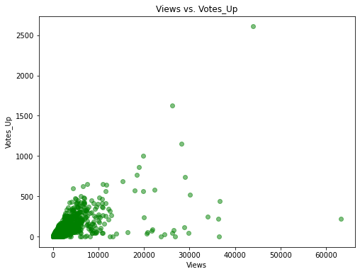
Data Visualisation After Applying the Conditions.
This scatter plot represents the Views Vs Responses.
This scatter plot represents the Views Vs Votes_down
This scatter plot represents the Views Vs Votes_up
After the above condition have been applied to the dataset we started observing the variations in the scatter plot
The conditions has changed the shape and size of the dataset:
Shape of the dataset after applying conditions: (14544, 10)

Slide 15
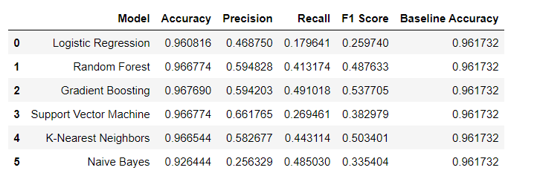
Applying various machine learning models on the dataset

Slide 16
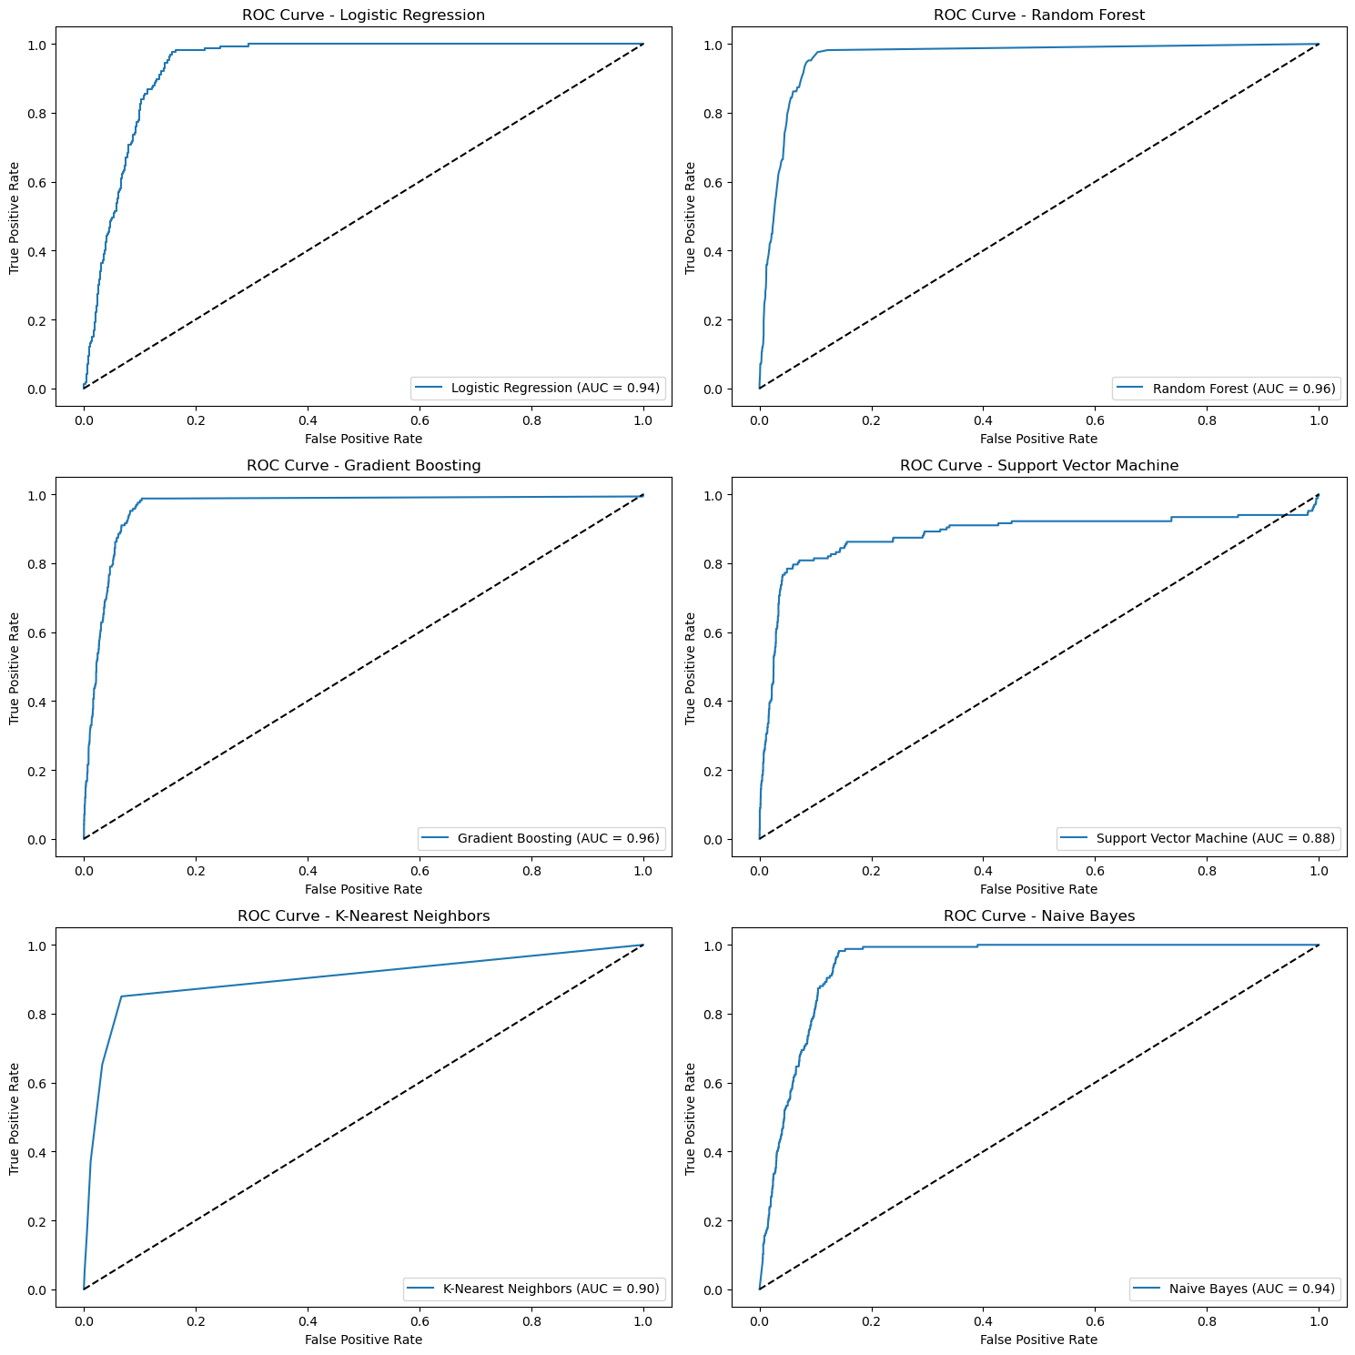
ROCs for the various ML models
The Random Forest Model and gradient boosting yields the best Accuracy under Curve results which is 0.96 , whereas the Support Vector Machine model has an AUC of 0.88.

Slide 17
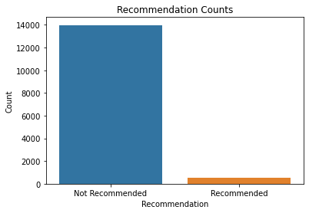
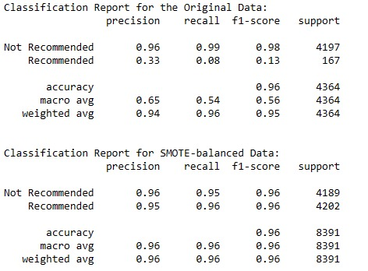
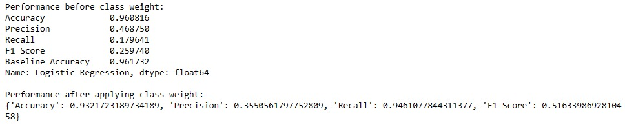
Results for SMOTE:
Class Imbalance
For the target variable we found this in consistency, so we have applied class weights and smote analysis techniques and the results are as follows.
So based on the outputs we opted to choose class weights over smote based on the results that we have received in the respective outputs

Slide 18
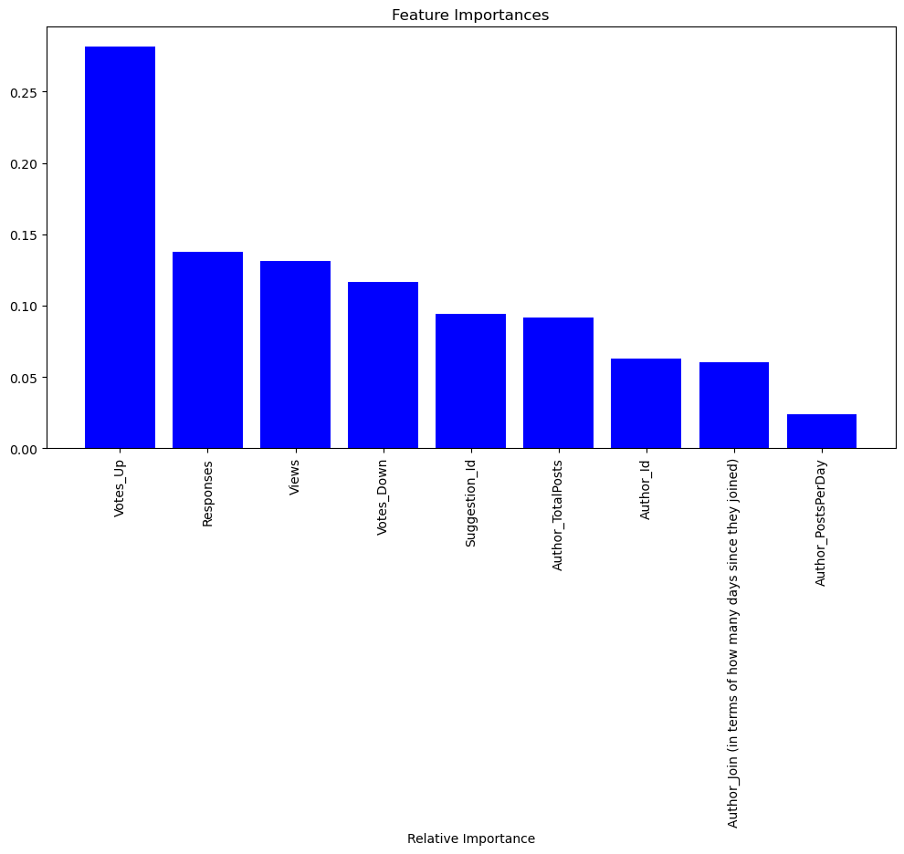
Feature Importance of all the attributes.
Feature Importance describes about the features which contribute the most towards the output of the model.
Here in our case, the top three attributes which contribute to the model’s output are Votes_Up, responses and Views.

Slide 19
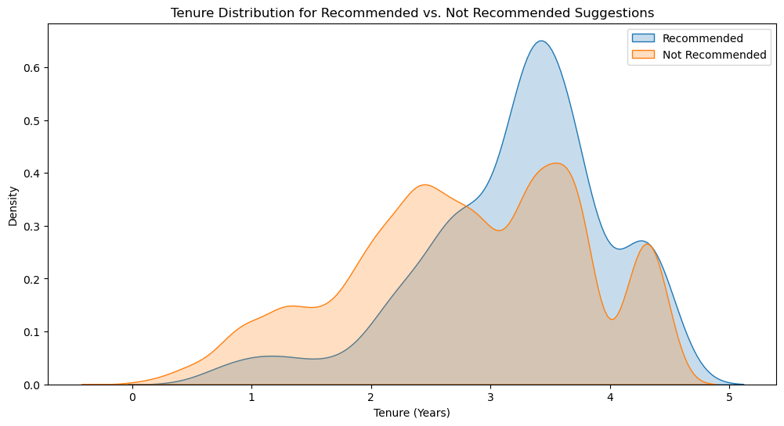
Tenure Distribution for Recommended and Not Recommended Suggestions.
The author_join has been converted to years for better interpretation of data.

Slide 20
Further Plan:
1. Currently Working on whether the employees with longer tenures making better suggestions than those with shorter ones? This as continuation from the above visualization the above slide.
2. Can the same data be used to rank employees based on their demonstrated ability to make predominantly good suggestions? Can it be used to identify groups of employees whose suggestions could be aggregated to provide more reliable suggestions than made by the best individuals?
3. Making recommendations to the IT department about better ways they could collect this data in the future. What other attributes would prove useful and why? Would it be possible to build a completely automated suggestion ranking system?

